Slide 1
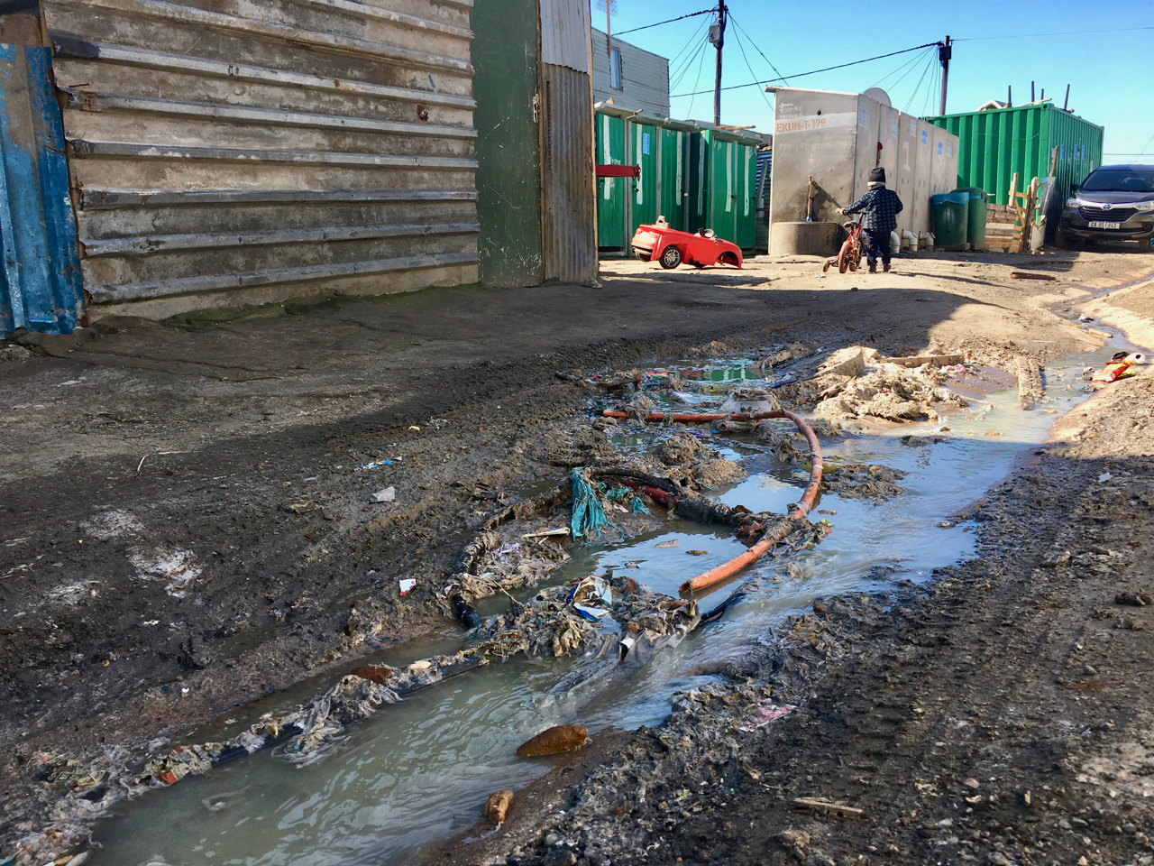
SISKIYOU COUNTY ENVIRONMENTAL HEALTH 2024
2023

Slide 2
HISTORICAL STAFF LEVELS VS CURRENT
Past (1990 ~ 2008) Director plus 9 REHS full time positions.
2008, 1 manager position was cut from the budget due to economic downturn.
Currently: Environmental Health Director plus 5 full time staff
(four are registered REHS) and two extra help REHS.
Environmental Health Division is operating at 65 percent of historical capacity.

Slide 3
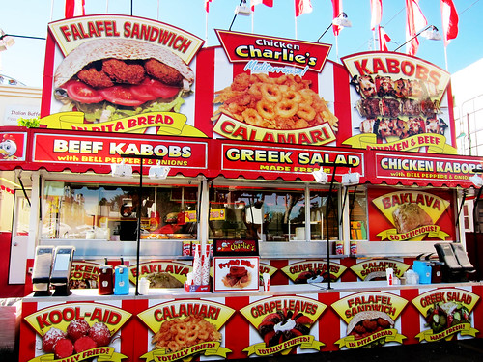
REHS INSPECTION TASK – BREAKDOWN
CONSUMER PROTECTION
FOODS
COTTAGE FOODS (cfo’s)
POOLS & SPAS
TEMPORARY EVENTS
BODY ART
VECTOR
RABIES
HOUSING

Slide 4
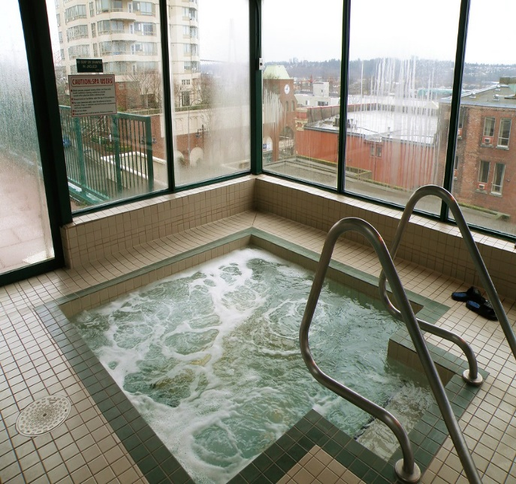
CONSUMER PROTECTION TOTALS
PERMITS
Foods 371
Temporary’s 161
CFO’S 39
Events 53
Pools & Spas 47
Body Art 9
INSPECTIONS: 1163 Conducted (820 in 2023) (1400, when fully staffed in 2008)

Slide 5
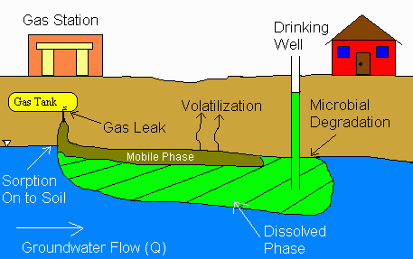
HAZARDOUS MATERIALS
CUPA (Certified Unified Program Agency) HAZ-MAT INVENTORY
Inspections are annual & tri-annual; underground storage tanks (UST) & above ground storage tanks (AST) respectively; update HMBP’s (hazardous materials business plans)
LAND FILLS – TRANSFER STATIONS
EMERGENCY RESPONSE
FIRE CLEANUP(S)
ILLEGAL CANNIBIS CULTIVATION

Slide 6
HAZMAT UNIT TOTALS
Approximately 500 CUPA permitted facilities. inspected conducted.
(244 in 2024)
Incidents – Emergency Response 25 incidents. (16 in 2023)
Fire Response – Cleanup effort approximately 350 staff hours for the Head Fire
Illegal Cannabis:
20 OPS conducted with the SC Sheriffs office to date @ approximately 150 hours of staff time

Slide 7
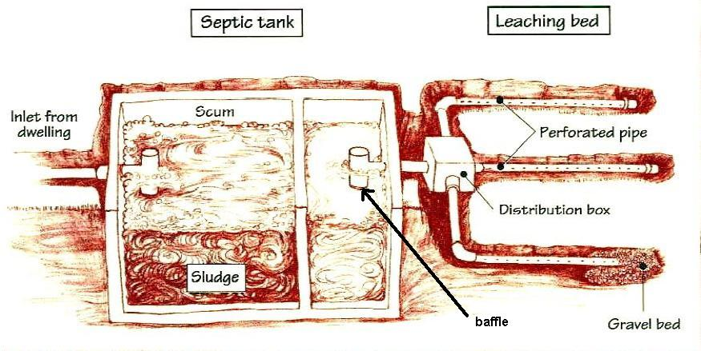
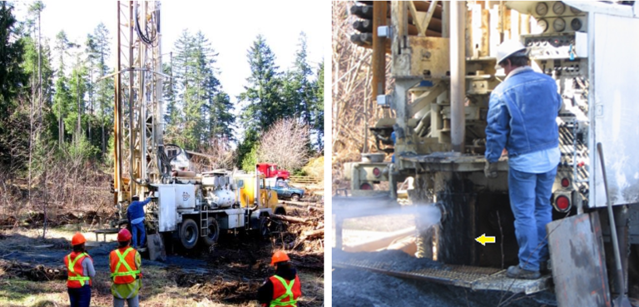
LAND USE
ONSITE SEWAGE DISPOSAL
SEPTIC SYSTEMS
WATER SUPPLY
WELLS
WATER SYSTEMS

Slide 8
LAND USE TOTALS
PERMITS
Septic permits and onsite evaluations: 104 total (136 in 2023): 20 new; 46 repair-replacement; 7 tanks;
Well permits: 119 total (98 in 2023); 56 domestic; 5 Ag.; 5 public; 41 monitoring & soil bores; 4 deepening’s; other; *note 7 dry wells (14 in 2023)*
Water Systems: 41 total; sampled quarterly by EH

